Slide 1


How to develop a successful Android App
王威淳(Wei-Chun-Wang)

Slide 2
Abstract
I find the data of Google Play Store Apps.
It contains the data and comments of about 10000 kinds of Apps.
I find out which market should I participate in and what are the features that my App should have.
Notes:
I found the data of Google Play Store Apps.
It contains the data and comments of about 10000 types of Apps.
I want to use the data to find out why some App are so successful while others don’t.

Slide 3
Motivation
Only a few of App are still live in our smart phone.
What are the customer cares about?
Add these attributes in the developing App.
Notes:
There are many Apps on Goole Play Store but only a few of them are still alive in our smart phone.
So if we want to develope a good App we have to find out what the customer cares the most.
If we can find them out, we can know what attributes that we may have to add or remove in our current developing App.

Slide 4
Dataset(s)
The dataset is from kaggle.
Name, category, rating, reviews, size, install times, price, content rating, last updated date, current version, Android version.
Link: https://www.kaggle.com/lava18/google-play-store-apps

Slide 5
Data Preparation and Cleaning
Data exploration.
Clean the data.
(1) Clean the NaN value.
(2) Delete the columns I won’t use.
(3) Change the value format.

Slide 6
Data Preparation and Cleaning
Data exploration.
Clean the data.
(1) Clean the NaN value.
(2) Delete the columns I won’t use.
(3) Change the value format.

Slide 7
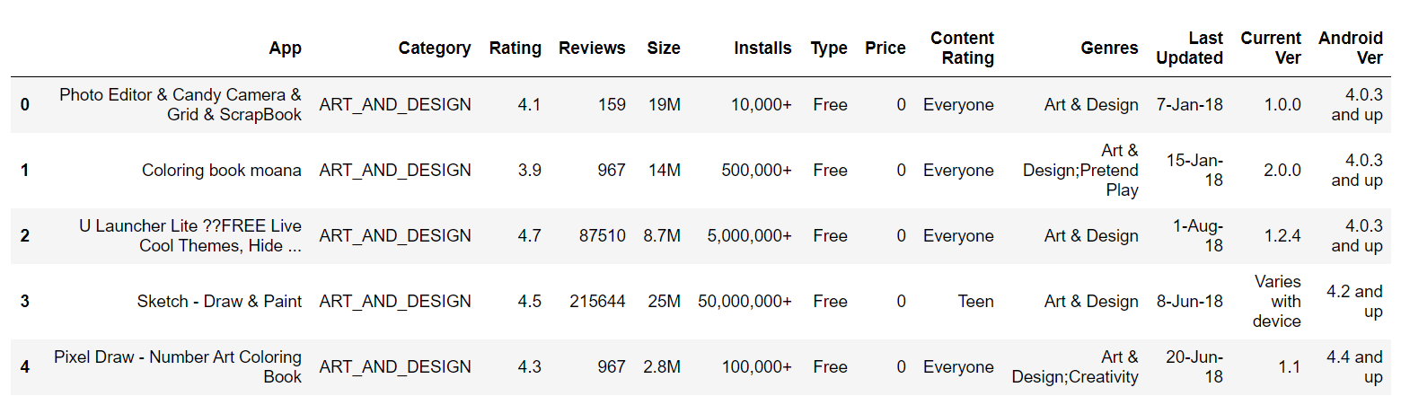
Data exploration
Google app store table

Slide 8
Data Preparation and Cleaning
Data exploration.
Clean the data.
(1) Clean the NaN value.
(2) Delete the columns I won’t use.
(3) Change the value format.

Slide 9
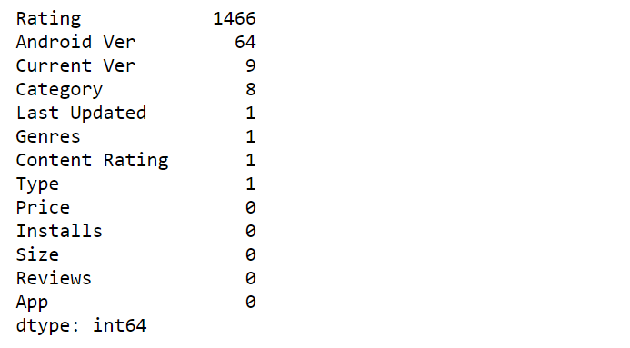
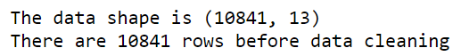
Clean the NaN value

Slide 10
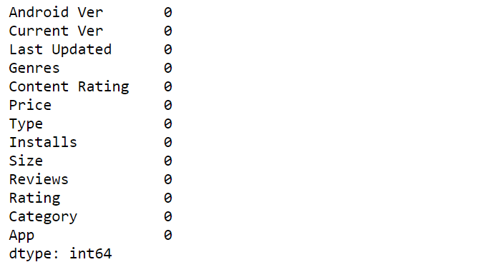
Clean the NaN value

Slide 11
Data Preparation and Cleaning
Data exploration.
Clean the data.
(1) Clean the NaN value.
(2) Delete the columns I won’t use.
(3) Change the value format.

Slide 12
Delete the columns I won’t use.
Category and genres seems the same.

Slide 13
Data Preparation and Cleaning
Data exploration.
Clean the data.
(1) Clean the NaN value.
(2) Delete the columns I won’t use.
(3) Change the value format.

Slide 14


Change the value format
Remove ‘M’, ‘k’ and ‘,’ in size and convert to float format.

Slide 15
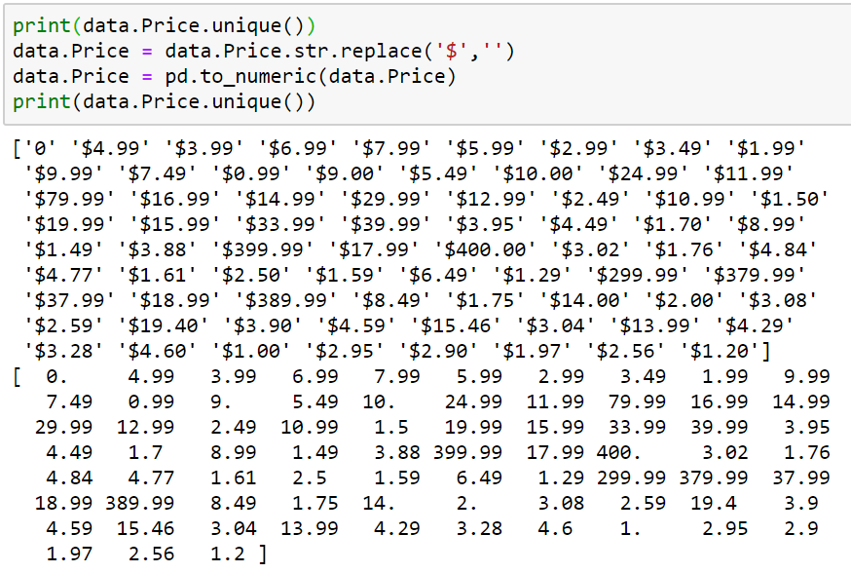
Change the value format
Remove ‘$’ in price and convert to float format.

Slide 16
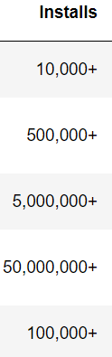
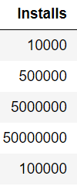
Change the value format
Remove ‘+’ and ‘,’ then convert to float format.

Slide 17
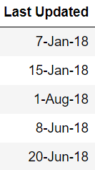
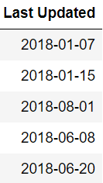
Change the value format
Convert last updated date to date-time format.

Slide 18
Research Question(s)
If I want to develop an App…..
Which market that everyone do the worst so I can easily go into?
What features my App should have?
How to evaluate my App is doing good or bad?

Slide 19
Methods
I used sns.regplot to draw the regression line and told the result.
I used size, reviews, price, last updated date to predict if installs > 500000 with knn.

Slide 20
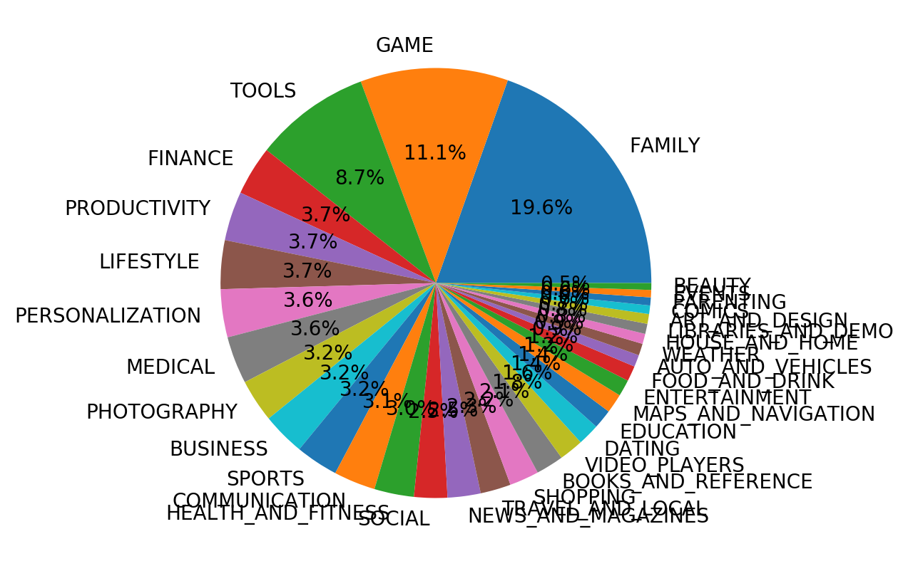
Findings

Slide 21
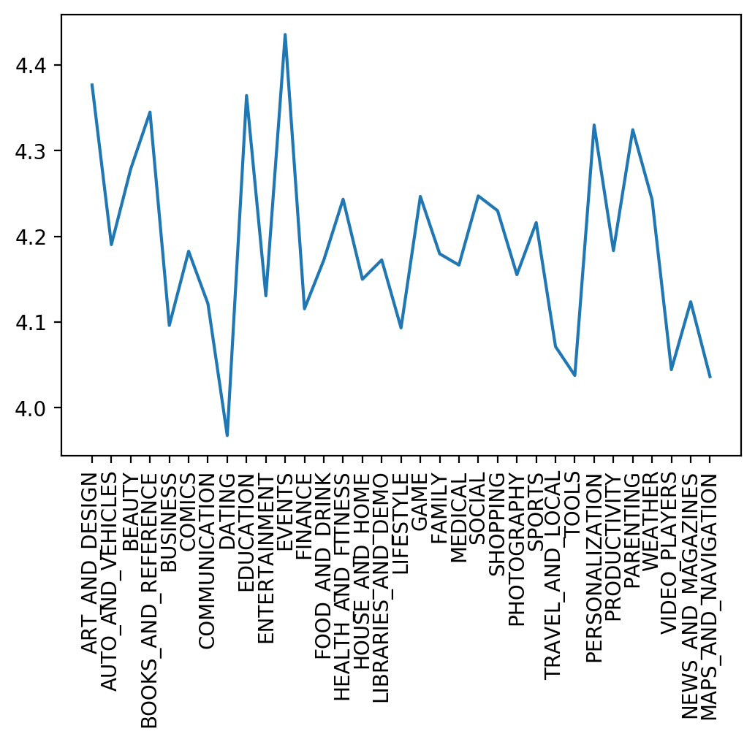
Findings-rating
The worst are
dating,
maps_and_navigation,
tools,
video_players,
lifestyle.

Slide 22
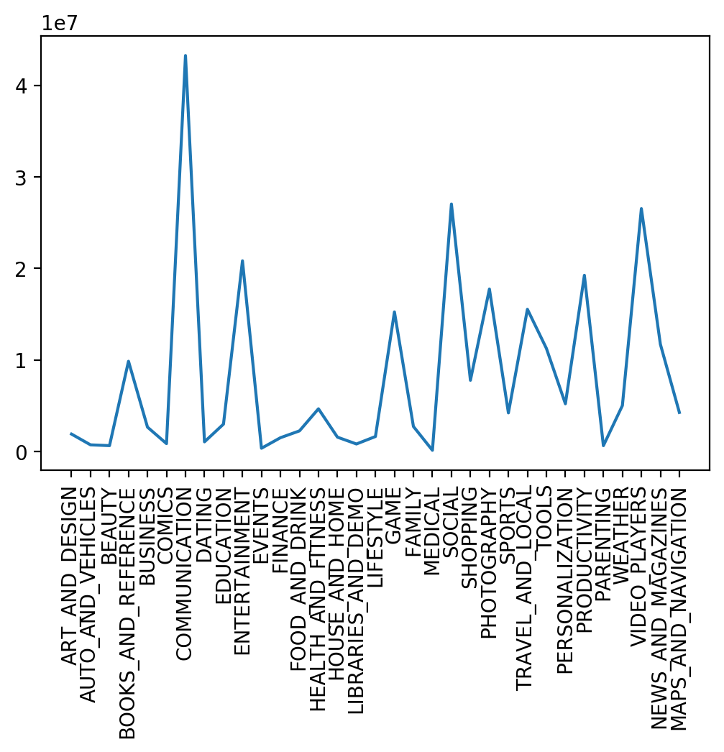
Findings-installs
Less than 1000000:
art_and_design,auto_and_vehicles,
beauty,books_and_reference,
business, comics, dating,
education, maps_andevents, finance food_and_drink,
health_and_fitness, house_and_home,
libraries_and_demo, lifestyle,
family medical, shopping sports,
personalization, parenting, weather,
_navigation.

Slide 23
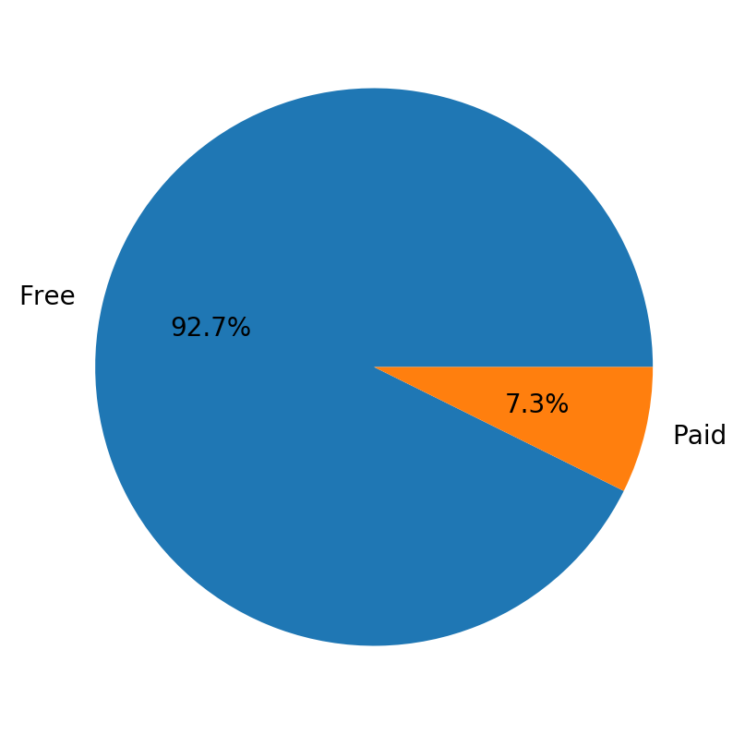
Findings-price
92.7% are free.

Slide 24
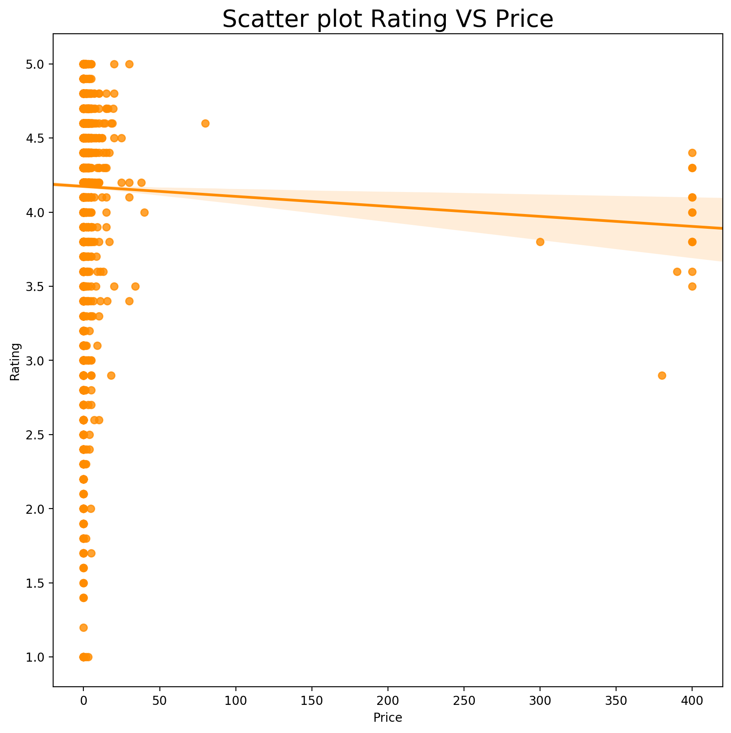
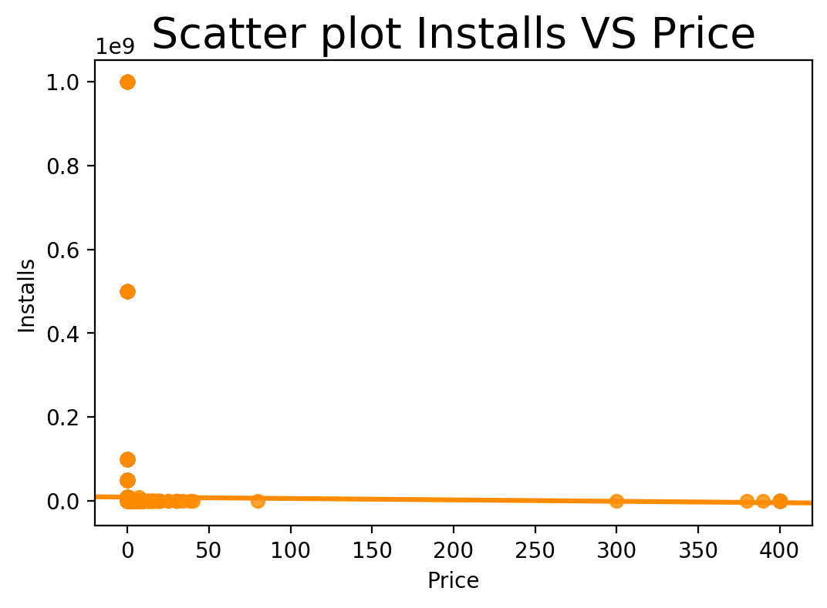
Findings-price vs rating & Installs
High price will lead to low rating.

Slide 25
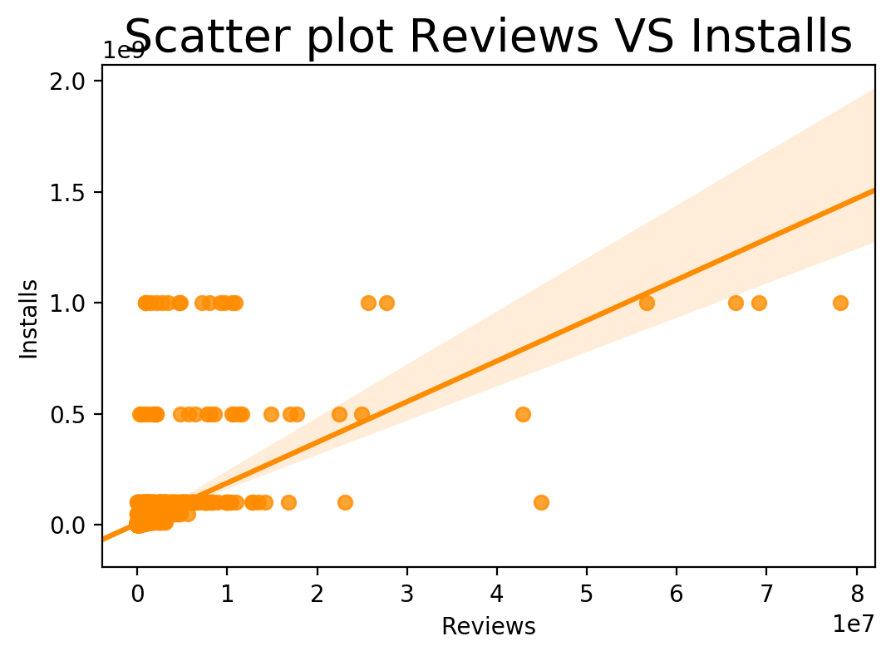
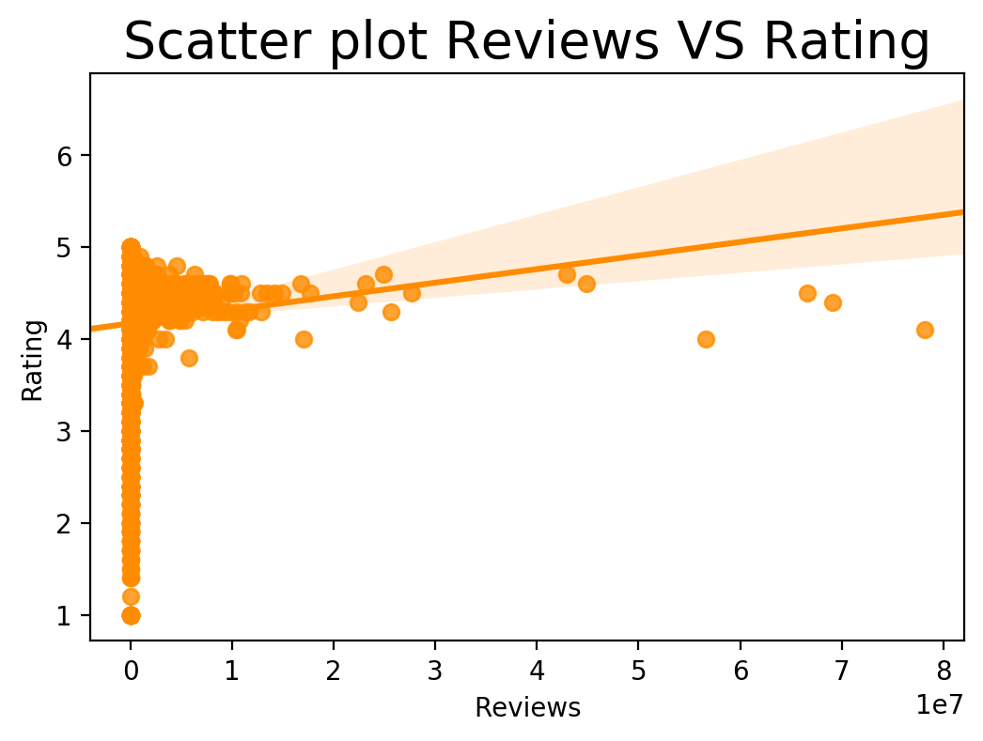
Findings-reviews vs rating & Installs
High reviews may have high installs and high rating.

Slide 26
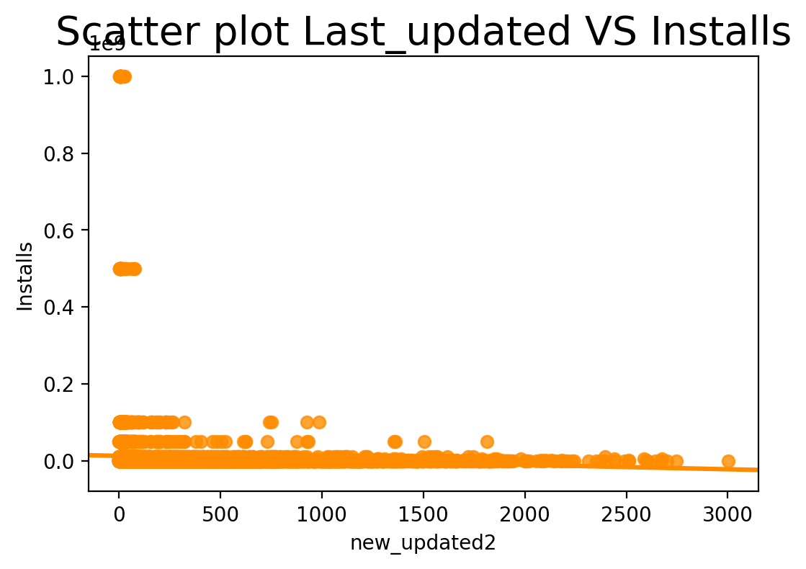
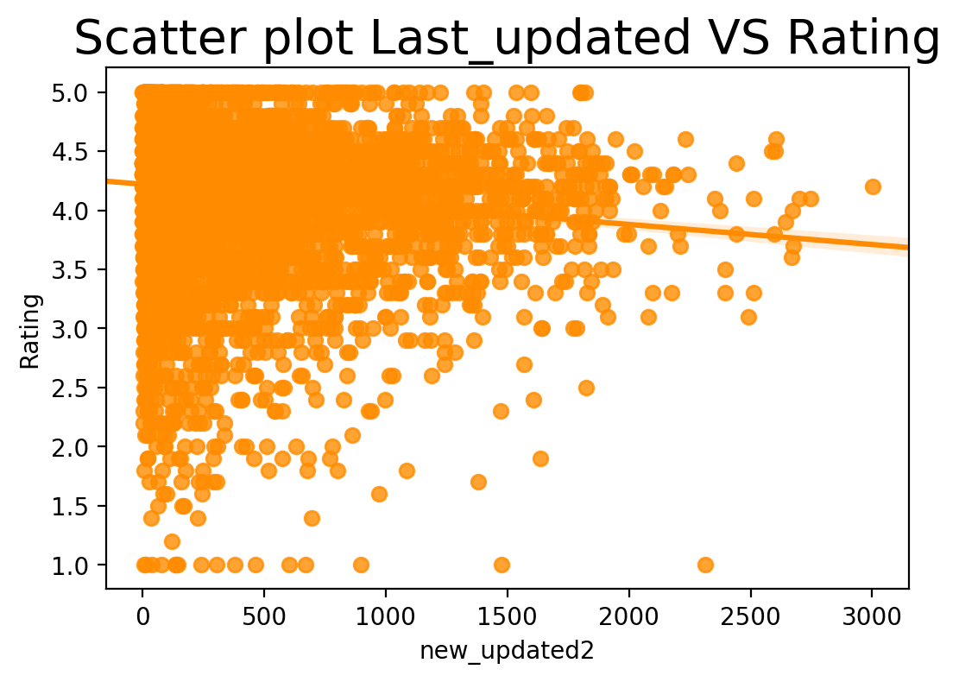
Findings-last updated date vs rating & Installs
Old last updated date affect will lead to low rating.

Slide 27

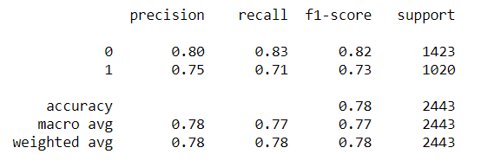
Findings
Knn using size, reviews, price, last updated date to predict if installs > 500000.

Slide 28
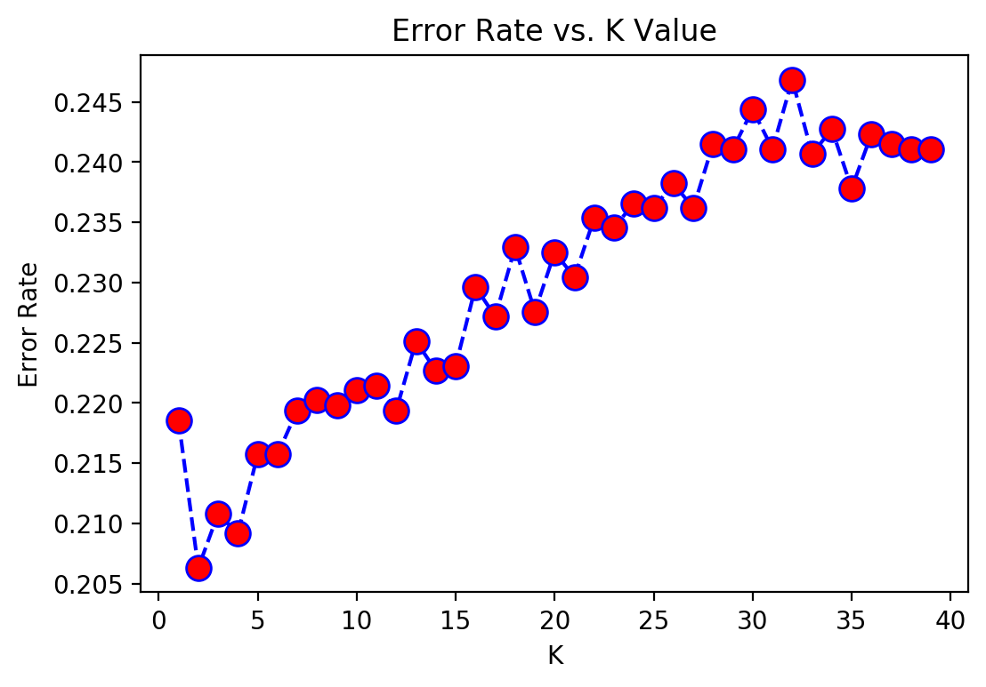
Findings
n_neighbors equals 2 is the best.

Slide 29
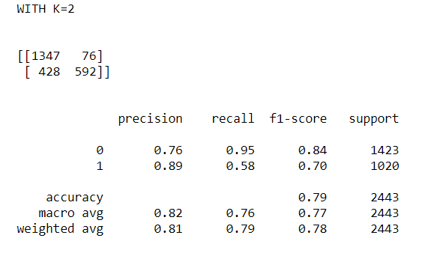
Findings
Last result:

Slide 30
Limitations
The data is not the newest data(2018).
The range of rating is too small.
Using size, reviews, price, last updated date to predict installs is not enough(acc=0.79).

Slide 31
Conclusions
If I want to develop an App…..
Which market that everyone do the worst so I can easily go into?
Dating, maps and navigation, lifestyle are really bad in installs and rating and not many people do these apps.
What features my App should have?
Low price, high reviews, updating more often are the keys to a good App.

Slide 32
Conclusions
How to evaluate my App is doing good or bad?
Put your size, reviews, price, last updated date in my knn model to predict your installs.

Slide 33
Acknowledgements
The dataset is from kaggle.
Link: https://www.kaggle.com/lava18/google-play-store-apps
I just use the methods told in class.

Slide 34
References
Pandas website
Seaborn website
Matplotlib website
Teaching material

Slide 35
Thank you

